Slide 1

SINGAPORE LABOUR MARKET ANALYSIS
[IT8701] Introduction to Programming for Data Science
SNG TIAN HAO, KEITH
1273881F

Slide 2

OVERVIEW
01
Introduction
02
Objectives
03
Methodology
04
Findings
05
Conclusion

Slide 3




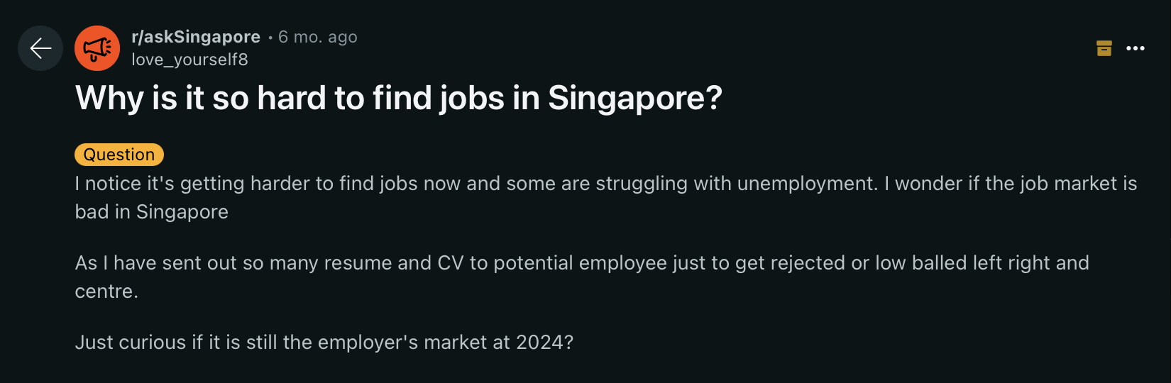
INTRODUCTION

Slide 4
INTRODUCTION
“With an improved economic outlook for 2024, sustained increase in the number of job vacancies, increased hiring optimism among firms over the next quarter, as well as declining retrenchment numbers, we expect the labour market to continue expanding and unemployment rates to remain low”
Ministry of Manpower (MOM) Q1 2024 Labour Market Report

Slide 5

INTRODUCTION
How Is The Labour Market?
In recent months, there has been growing sentiment that Singapore's economy is facing significant challenges. Concerns about economic downturns, fluctuating markets, and domestic economic pressures have sparked discussions about the state of the job market. Despite these worries, the Ministry of Manpower’s (MOM) outlook suggests that growth opportunities may still be on the horizon.
As such, this analysis seeks to assess the current state of Singapore’s labour market amidst prevailing concerns. Specifically, we will focus on comparing Singapore’s labour market globally and explore job opportunities across various industries and sectors, with the aim of helping job-seekers achieve both job security and satisfaction.

Slide 6

OBJECTIVES
Research Questions
What is the current state of Singapore’s labour market in comparison to other countries?
Which sectors or industries in Singapore offer the greatest job security in the present economic climate?
Where can job-seekers look for opportunities within the various sectors or industries?
How can job-seekers find employment that aligns with their expectations and offers satisfaction?
Assumption
Job-seekers assumed to possess versatile skillsets with relevant qualifications, allowing them to apply for similar job roles across various industries (e.g., working as a data analyst / sales manager in the IT sector versus the petroleum industry)

Slide 7

METHODOLOGY (DATASETS & TOOLS)
Datasets
Overall Unemployment Rate, Annual
OECD Annual Unemployment Rates
World Bank Country and Lending Groups
Retrenchment By Industry
Average Monthly Recruitment/Resignation Rate by Industry and Occupational Group
Occupational Wages within each Major Occupational Group by Industry
Average Weekly Paid Hours Worked Per Employee by Industry and Type of Employment
Distribution of Full-Time Employees By Annual Leave Entitlement
Proportion of Establishments That Provided Non-Statutory Leave by Type
Proportion of Establishments Offering Scheduled FWAs-Industry
Technologies/Libraries Used
Python |  | MySQL
Pandas | Seaborn | MySQL 8.0.35 for database creation inserting data into tables, and querying
Numpy | Plotly
Requests | Matplotlib
Sklearn | MySQLconnector
4

Slide 8
METHODOLOGY (APPROACH)
Analysis Framework
Job opportunities, benefits, and satisfaction
Job security and attrition
Labour market sensing
Singapore
vs Global Unemployment
Retrenchment Rates
Turnover Rates
Wage Comparison
Weekly Hours Worked
Leave Package Comparison
Flexible Working Arrangements (FWA)
Comparison of Singapore’s labour market health with other high income countries
Job security analysis using retrenchment rates in the past 10 years by industry and sector
Analysis of job satisfaction and opportunities using latest resignation and recruitment rates in 2023
Comparison of monthly wages across different occupation groups and industries using wage data from 2022
Work-life balance analysis by industry and sector using weekly hours worked data from 2023
Comparison of annual leave package by industry based on 2022 leave data
FWA analysis by industry based on 2022 FWA data

Slide 9
METHODOLOGY (APPROACH)
Analysis Framework
Job opportunities, benefits, and satisfaction
Job security and attrition
Labour market sensing
Singapore
vs Global Unemployment
Retrenchment Rates
Turnover Rates
Wage Comparison
Weekly Hours Worked
Leave Package Comparison
Flexible Working Arrangements (FWA)
Comparison of Singapore’s labour market health with other high income countries
Job security analysis using retrenchment rates in the past 10 years by industry and sector
Analysis of job satisfaction and opportunities using latest resignation and recruitment rates in 2023
Comparison of monthly wages across different occupation groups and industries using wage data from 2022
Work-life balance analysis by industry and sector using weekly hours worked data from 2023
Comparison of annual leave package by industry based on 2022 leave data
FWA analysis by industry based on 2022 FWA data

Slide 10
METHODOLOGY (APPROACH)
Analysis Framework
Job opportunities, benefits, and satisfaction
Job security and attrition
Labour market sensing
Singapore
vs Global Unemployment
Retrenchment Rates
Turnover Rates
Wage Comparison
Weekly Hours Worked
Leave Package Comparison
Flexible Working Arrangements (FWA)
Comparison of Singapore’s labour market health with other high income countries
Job security analysis using retrenchment rates in the past 10 years by industry and sector
Analysis of job satisfaction and opportunities using latest resignation and recruitment rates in 2023
Comparison of monthly wages across different occupation groups and industries using wage data from 2022
Work-life balance analysis by industry and sector using weekly hours worked data from 2023
Comparison of annual leave package by industry based on 2022 leave data
FWA analysis by industry based on 2022 FWA data

Slide 11
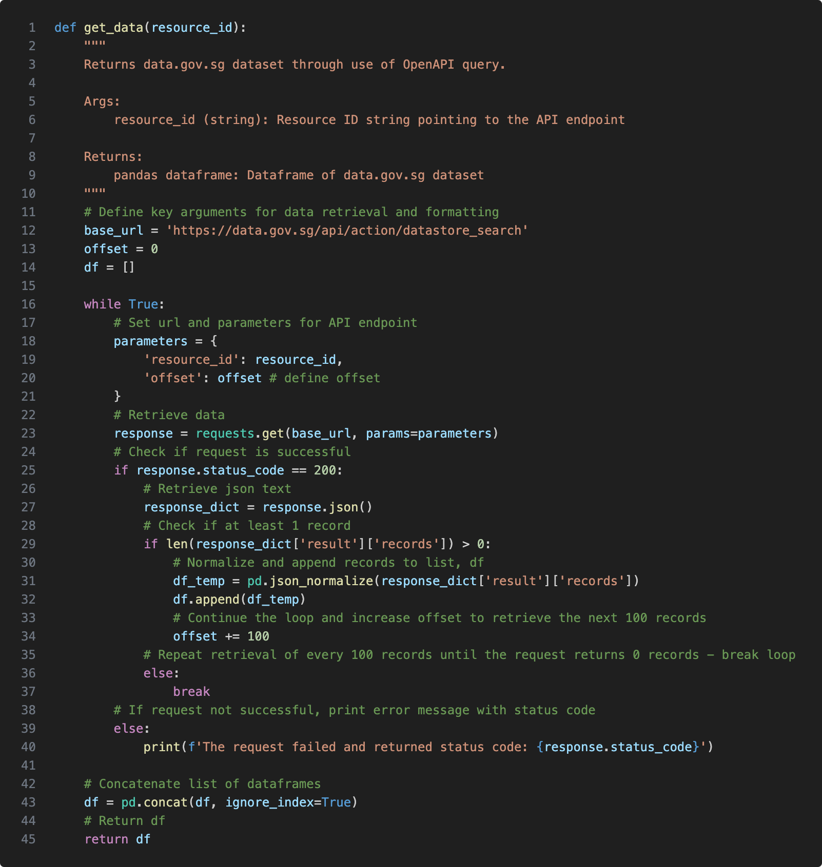
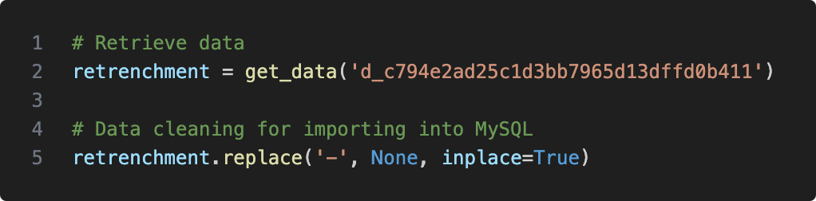
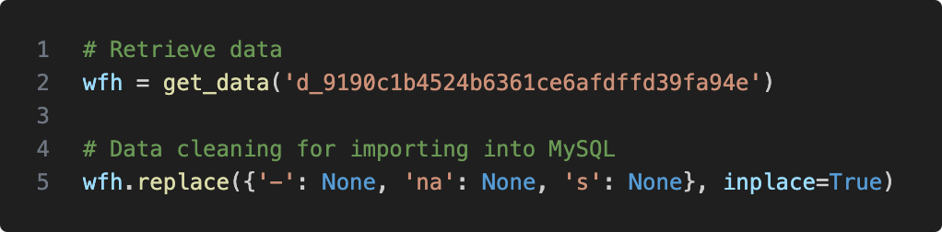
METHODOLOGY (DATA PRE-PROCESSING)
Extract-Transform-Load (ETL) Workflow
Custom function to call API and save data into pandas data frame
Downloaded datasets using self-defined function to call APIs (wherever possible)
Cleaned raw data (minimally) by replacing blanks and nulls with None data type to mitigate data integrity errors enforced by MySQL when executing INSERT INTO statement
Define API URL (provided on data.gov.sg)
Frequently encountered error during attempts to import data into MySQL!
Specify end-point for individual datasets
Retrieve data
Parse JSON data into pandas data frame
Replace NULL values as None type
Iterate until all available rows have been read and saved
Different characters to replace to ensure data cleanliness and integrity
4
Concatenate and save data into data frame

Slide 12
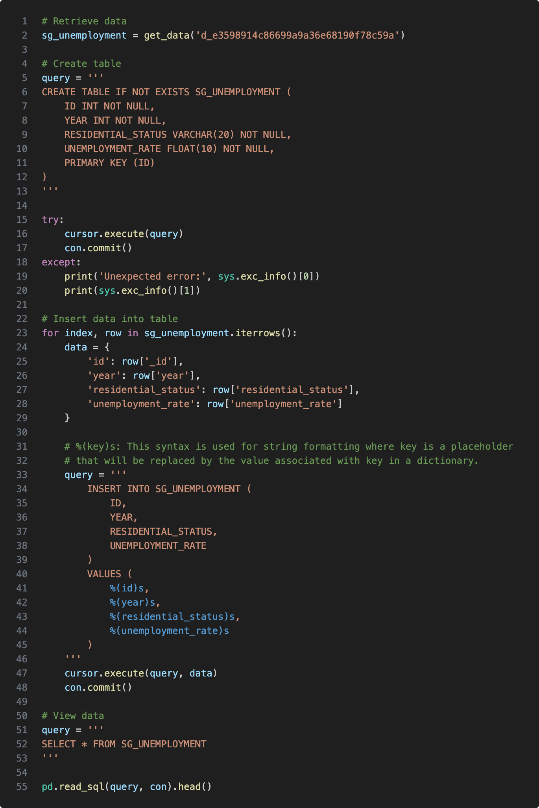
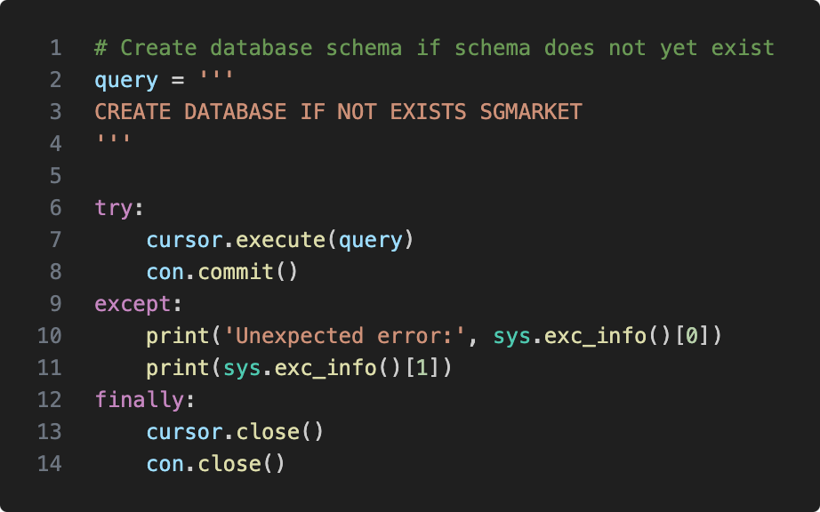
METHODOLOGY (DATA PRE-PROCESSING)
Define and create table in MySQL for loading dataset
Database Schema Creation
Specify attribute data types after inspecting raw data
Created MySQL database schema to facilitate loading of downloaded tables
Execute SQL query through Python to create table
Ensures that I can re-run the code without error
Iterate through each row to retrieve data for inserting into table
Insert query to run in MySQL
Importing of Data Tables into MySQL Database
After cleaning of datasets to ensure data integrity based on constraints defined in CREATE TABLE statement, data loaded using INSERT INTO statement
Once loaded, test query is run to extract table from MySQL in Python using SELECT statement and result set is visually inspected for validation
Execute SQL query through Python to insert values
4
Check that data has been successfully inserted by querying data and doing a quick inspection

Slide 13
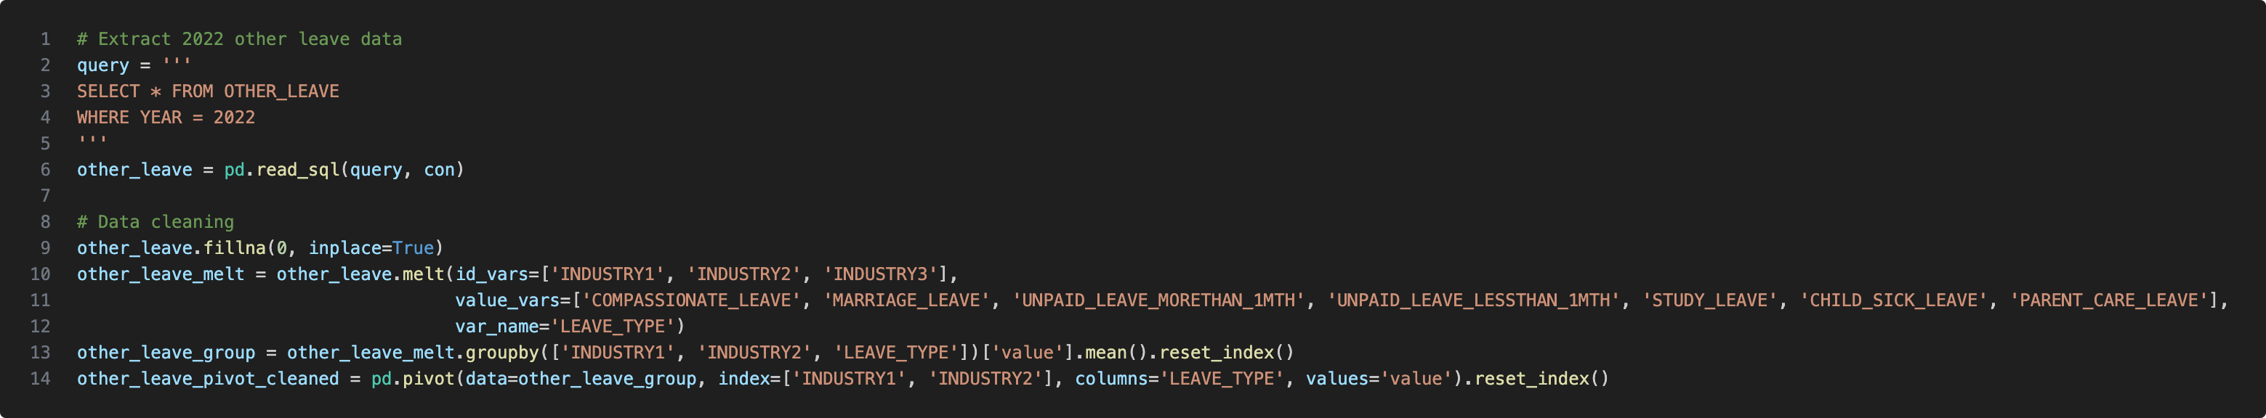
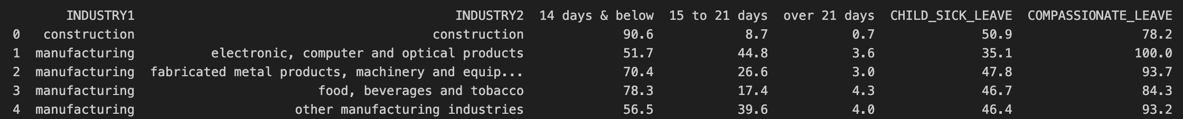
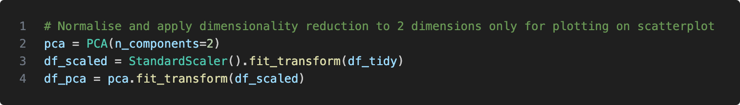
METHODOLOGY (DATA CLEANING & MANIPULATION)
Fill missing NAs with 0 to make sure means are calculated correctly
Melt wide format data frames into long format for easier manipulation
Re-pivot into long format for specific analysis / visualisation
Data Cleaning
To facilitate analysis, datasets were cleaned using Pandas after extracting the necessary from MySQL
Common issues encountered:
NaNs which affects calculation of mean
Raw data often in wide format (not friendly for visualisation)
Tables with common columns unable to be merged due to inconsistent casing/punctuation
Annual leave data
Other leave data
Data Manipulation
Join key
Joining relevant data tables for comprehensive analysis
e.g., Left join Annual Leave and Other Leave tables on INDUSTRY column to analyse overall leave package
Aggregating data to calculate means at different levels for analysis
Dimensionality Reduction
Calculation of means for various metrics for each year, and industry
Used Principal Component Analysis (PCA) to reduce number of dimensions (fields)
Allows for plotting of data on a 2-D axis for analysis while preserving information from raw data
4

Slide 14
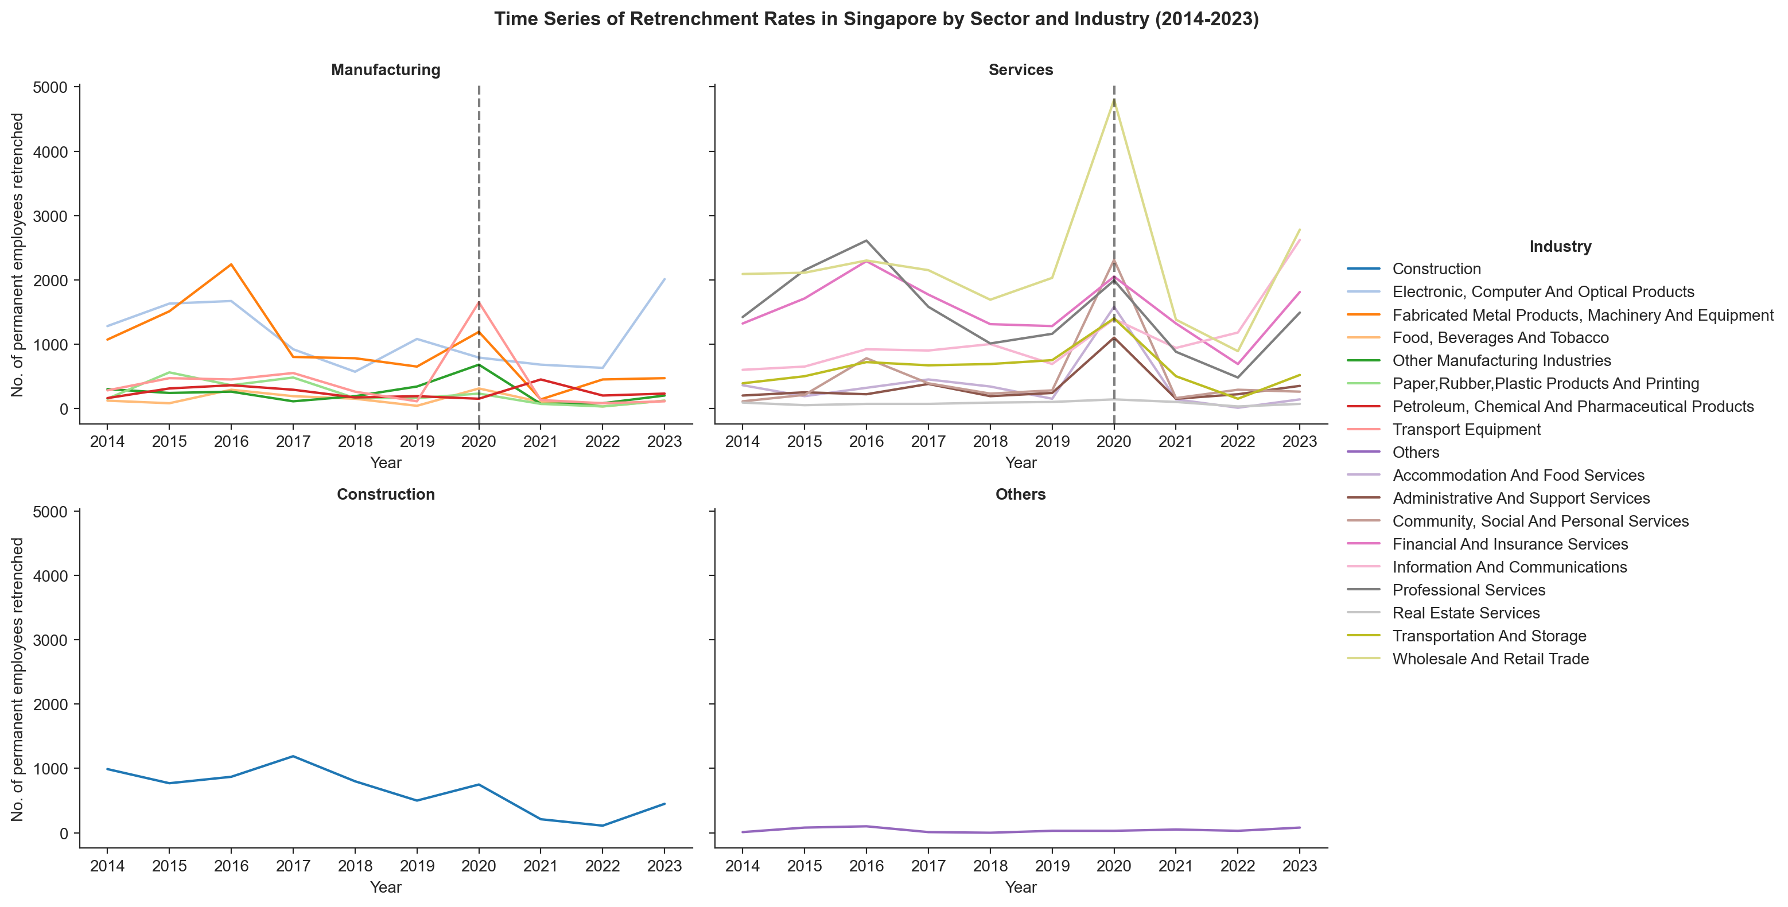
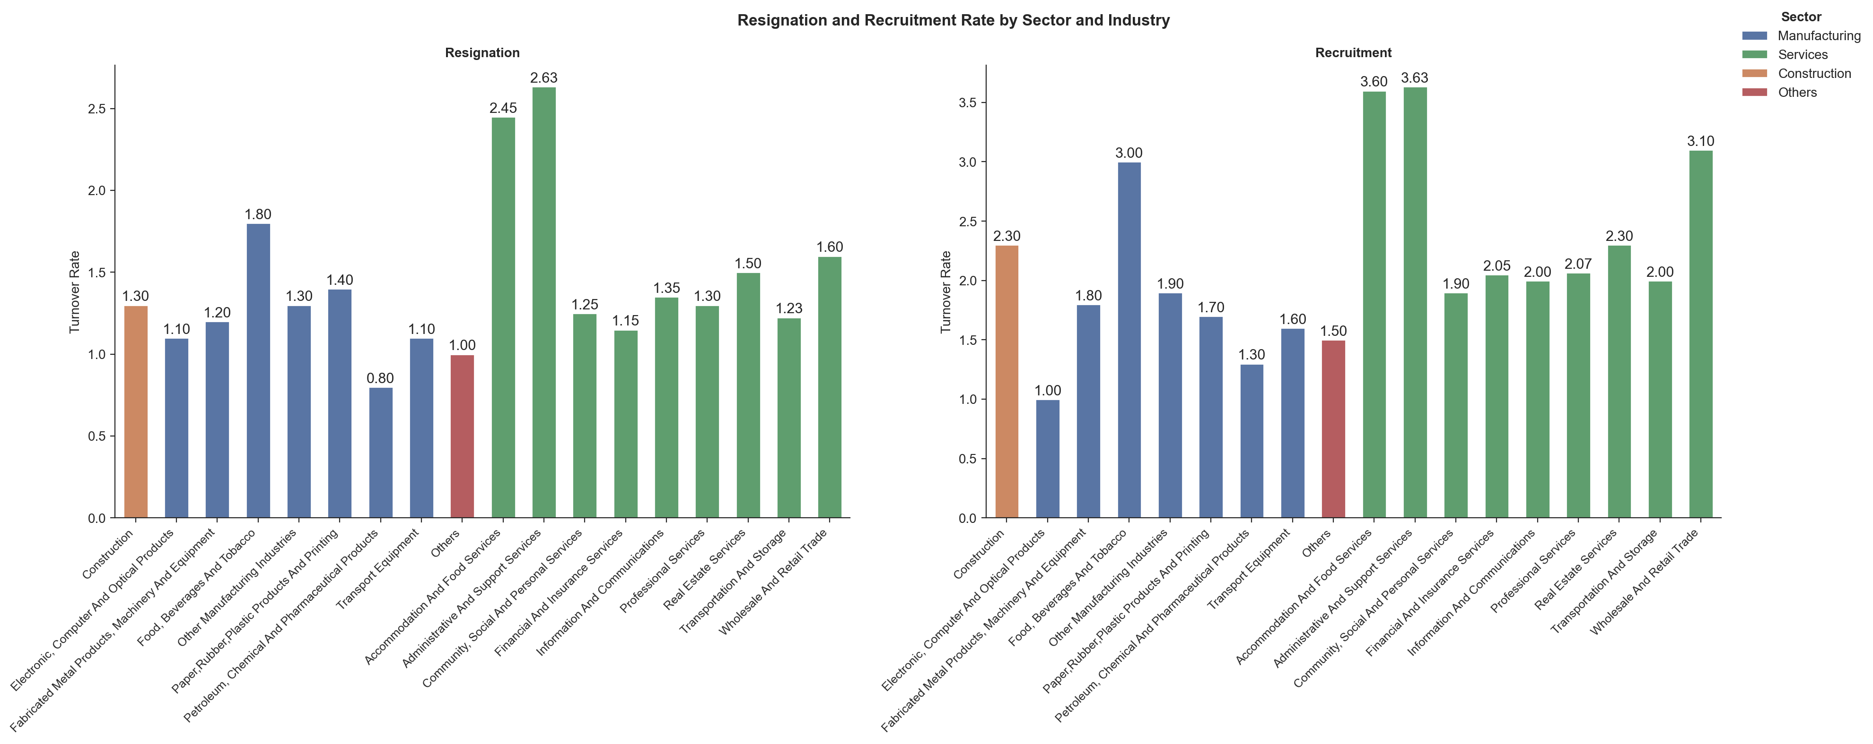
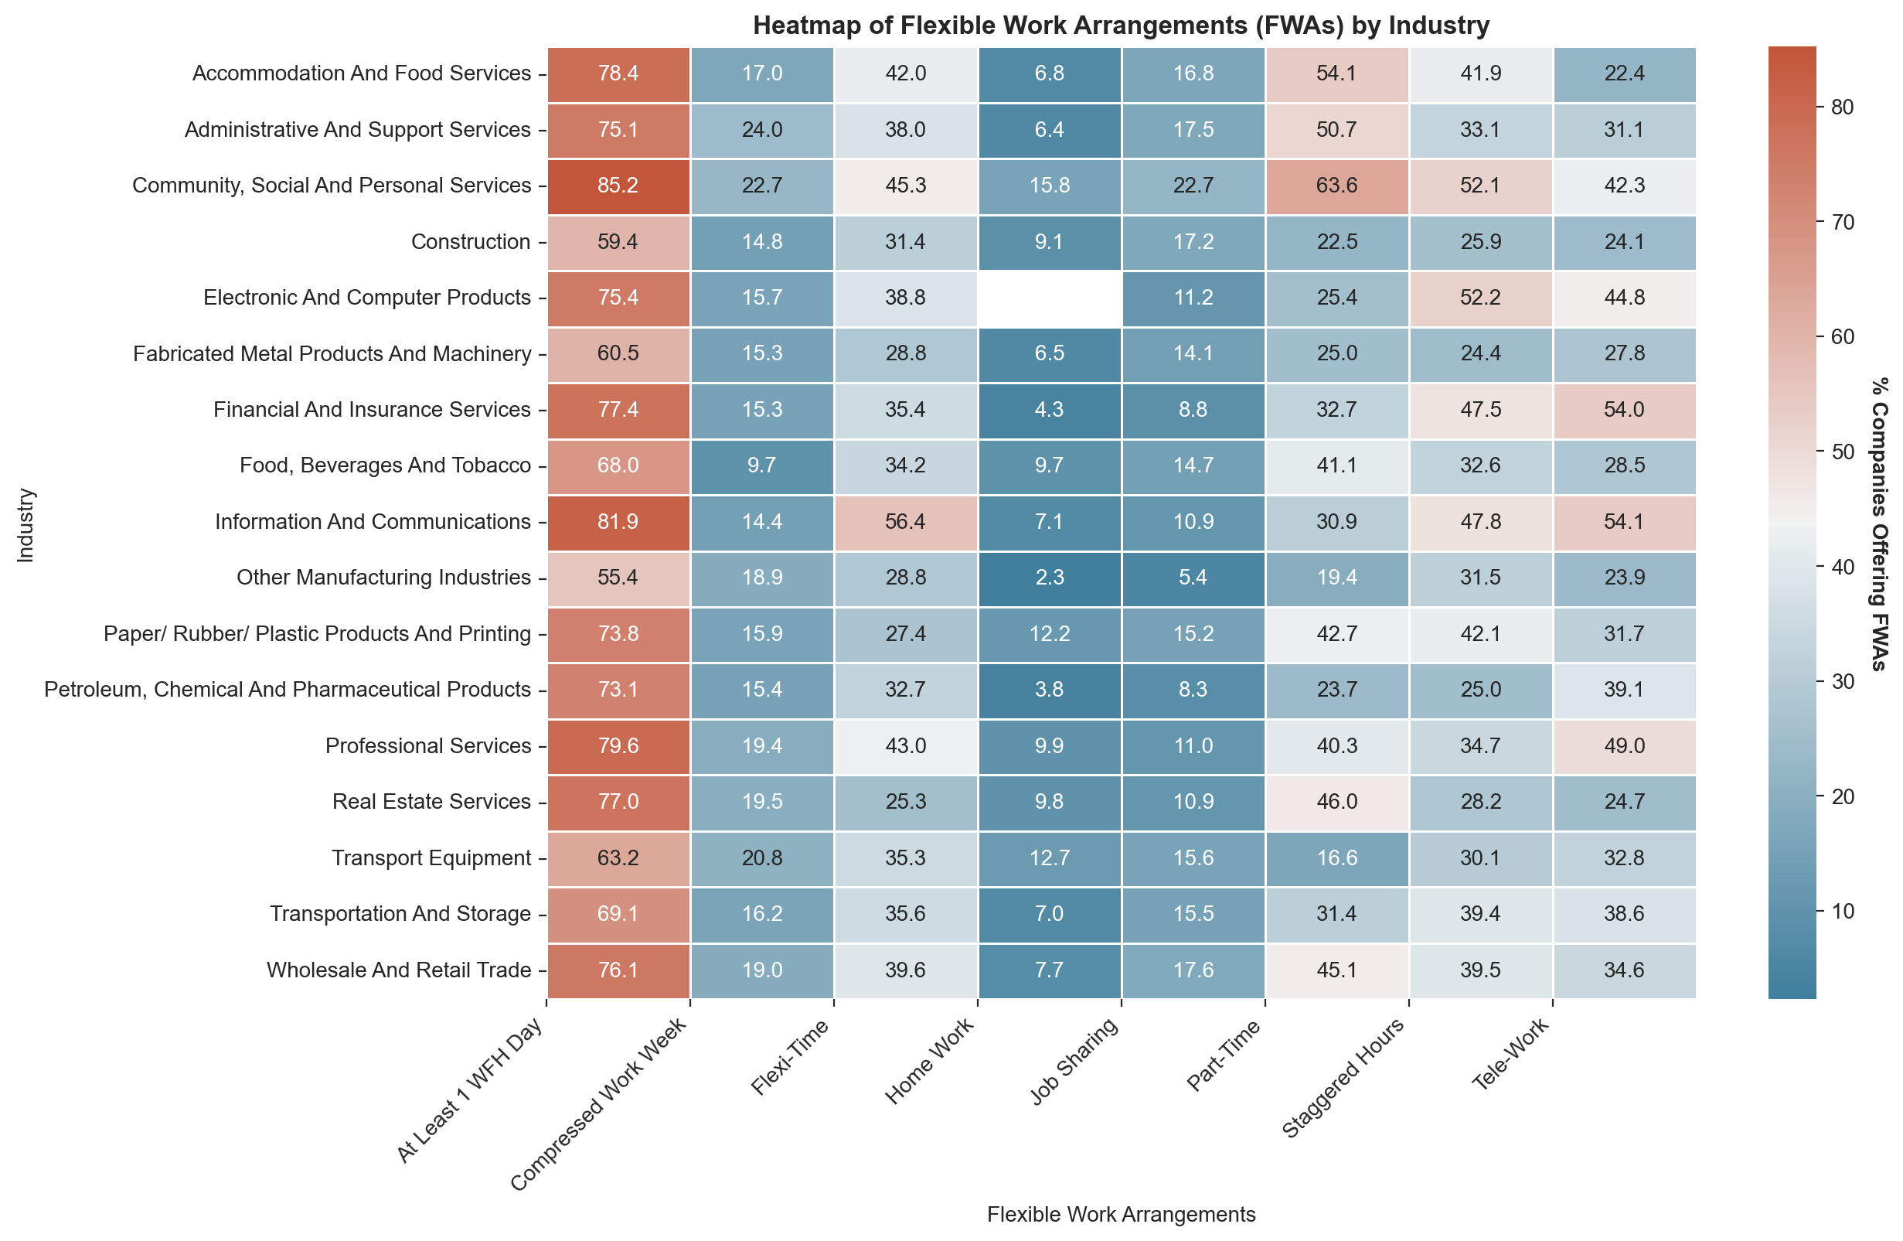
METHODOLOGY (ANALYSIS)
Data Visualisation
Used Seaborn, Plotly to analyse different facets of the labour market
Types of charts used in this analysis:
Line chart (for time series)
Pie chart (for comparison of proportions)
Bar chart (for comparison of means across different categories)
Scatter plot (for PCA analysis)
Heat map (for comparison of multiple dimensions across different categories)

Slide 15
FINDINGS (TOPLINE LABOUR MARKET COMPARISON)
What is the current state of Singapore’s labour market in comparison to other countries?

Slide 16
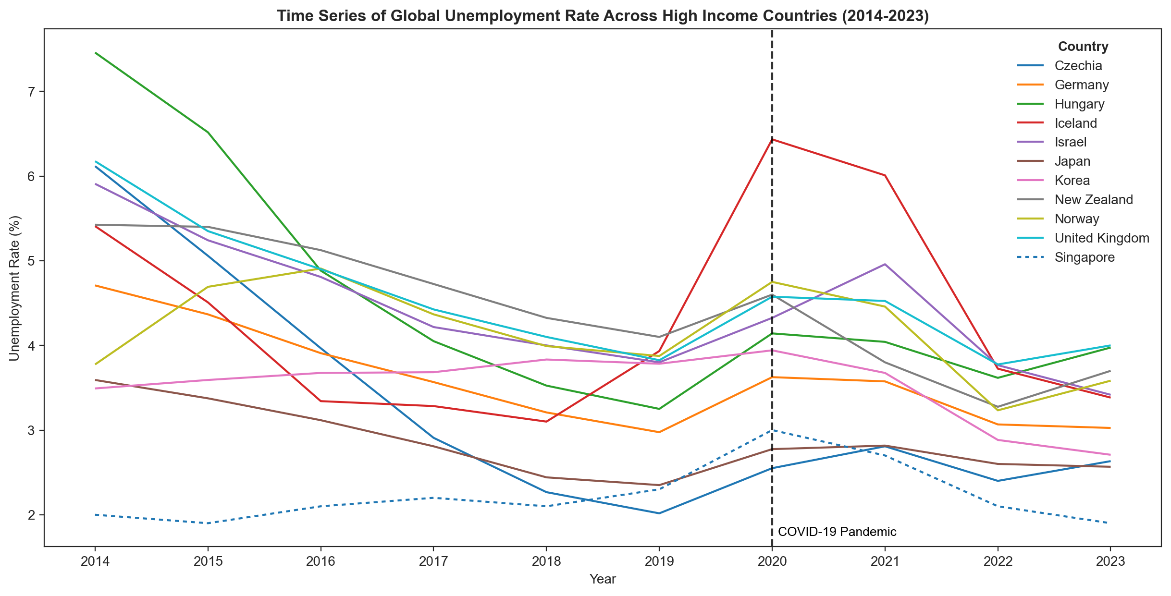
FINDINGS (TOPLINE LABOUR MARKET COMPARISON)
Relative to the top 10 high income countries with the lowest average unemployment rates, Singapore consistently has one of the lowest unemployment rates
Notes:
[Internal note] Will segue into the “what does this mean for the average Joe who is struggling to find a job?” during my presentation. Trying to leave 1 key takeaway on each slide and talking thru my points.

Slide 17
FINDINGS (JOB SECURITY)
Which sectors or industries in Singapore offer the greatest job security in the present economic climate?

Slide 18
FINDINGS (JOB SECURITY)
Analysis
Time series to allow job-seekers to identify industries that are thriving or not doing well
Insights
Certain industries continue to see rising retrenchment levels, possibly indicating the decline (either short/long-term) of these industries
Most of the decline appears to be in the Services sector (IT, Wholesale & Retail Trade, Finance & Insurance industries)
Spike in 2020 due to COVID-19
Notes:
[Internal note] To verbalise “job-seekers should focus on low retrenchment industries”.

Slide 19
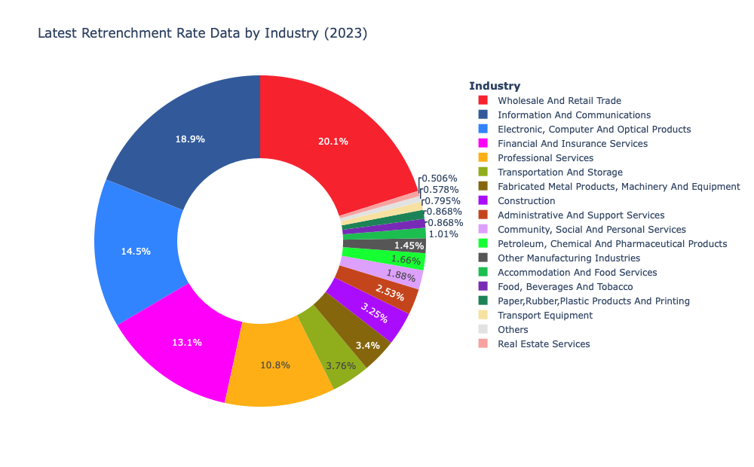
FINDINGS (JOB SECURITY)
Analysis
Pie chart to examine proportion and absolute retrenchment of each industry in latest year
Insights
With a focus on immediate job security, values from 2023 reflect current job market condition across industries
Majority of more ‘stable’ industries are within the Manufacturing sector
Within the Services sector, industries such as Accoms. & Food Services; Admin & Support Services; Community, Social & Personal Services are doing better
Notes:
[Internal note] Highlight that this serves as deep-dive (and to fulfil assignment criteria).

Slide 20
FINDINGS (JOB OPPORTUNITIES)
Where can job-seekers look for opportunities within the various sectors or industries?

Slide 21
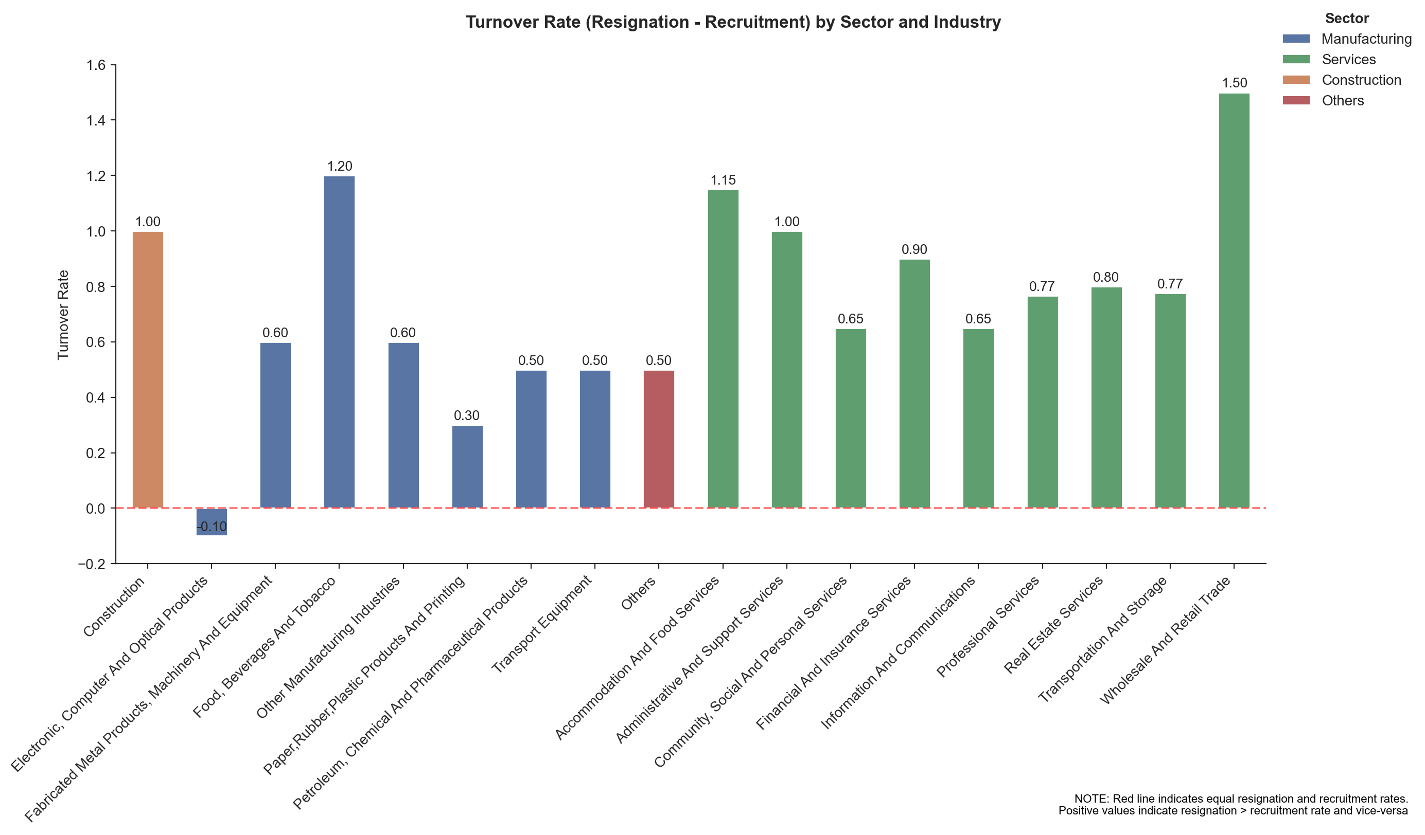
FINDINGS (JOB OPPORTUNITIES)
Analysis
Comparison of latest turnover rate across industries to elucidate job opportunities
Insights
Resignations and recruitment signals job availability, consider overall turnover rate to guide job search (positive = opportunities available)
Wholesale & Retail Trade has low resignation but high recruitment, indicating industry growth
However, previous analysis shows high retrenchment, implying restructuring within industry — reducing redundancy, focus on more strategic roles
Caveat: Important to note that positive turnover (i.e., high recruitment) not entirely indicative of residential employment. Job-seekers should be mindful of prevailing market conditions and labour regulations / laws which are not considered in this analysis

Slide 22
FINDINGS (JOB EXPECTATIONS & SATISFACTION)
How can job-seekers find employment that aligns with their expectations and offers satisfaction?

Slide 23
FINDINGS (JOB SATISFACTION)
Analysis
Insights
Breakdown of turnover into resignation and recruitment across industries for granularity as resignations serve as proxy for satisfaction, indicating labour-management relations
High correlation between resignation and recruitment (r = 0.913, p ≈ 0.00)
Accoms. & Food Services and Admin. & Support Services industries indicative of low job satisfaction
Other than resignations, important to consider other indicators
Caveats:
Important to note that positive turnover (i.e., high recruitment) not entirely indicative of residential employment. Job-seekers should be mindful of prevailing market conditions and labour regulations / laws which are not considered in this analysis
Low resignations not entirely indicative of high satisfaction. Job-seekers to keep in mind that there are other indicators of satisfaction which are not explored in this analysis.
Notes:
[Internal note] To verbalise I’m breaking down turnover rate from previous slide into individual components to analyse job satisfaction.

Slide 24
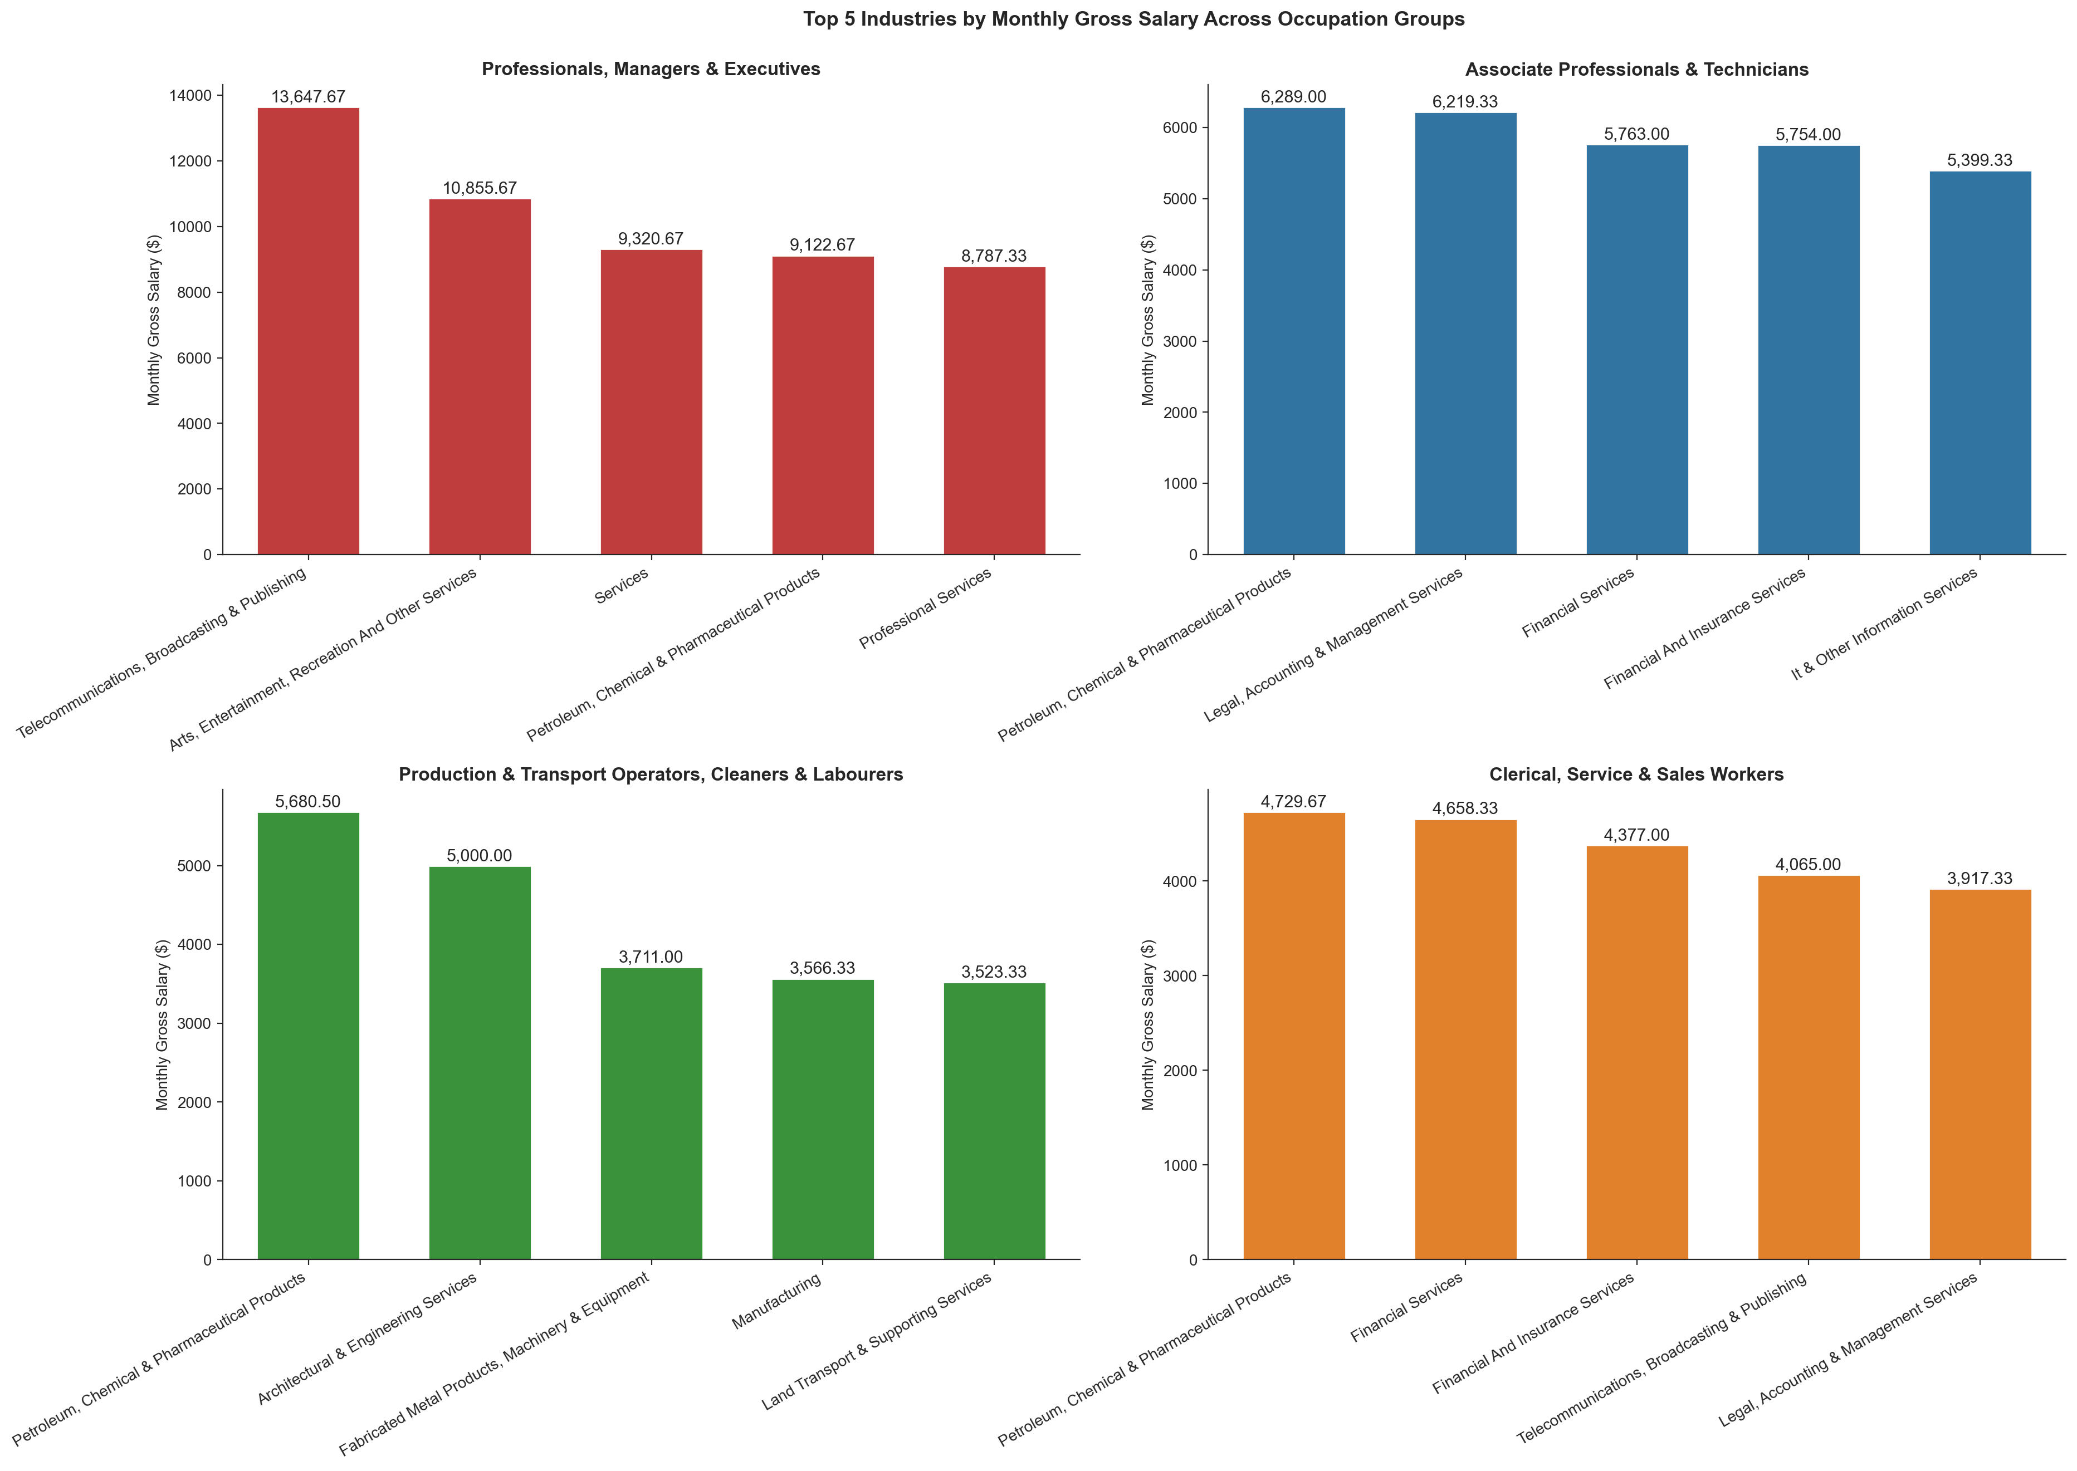
FINDINGS (WAGES)
Analysis
Comparison of top-earning industries across occupation groups to identify opportunities
Insights
PMEs have highest wages generally, especially from Telecommunications, Broadcasting & Publishing industry
Sales Manager
ICT Sales & Services Professional
Systems Analyst
Across remaining occupation groups, Petroleum industry the most lucrative
Engineering Technician
Supervisor / Foreman
Office / Information / Production Clerk

Slide 25
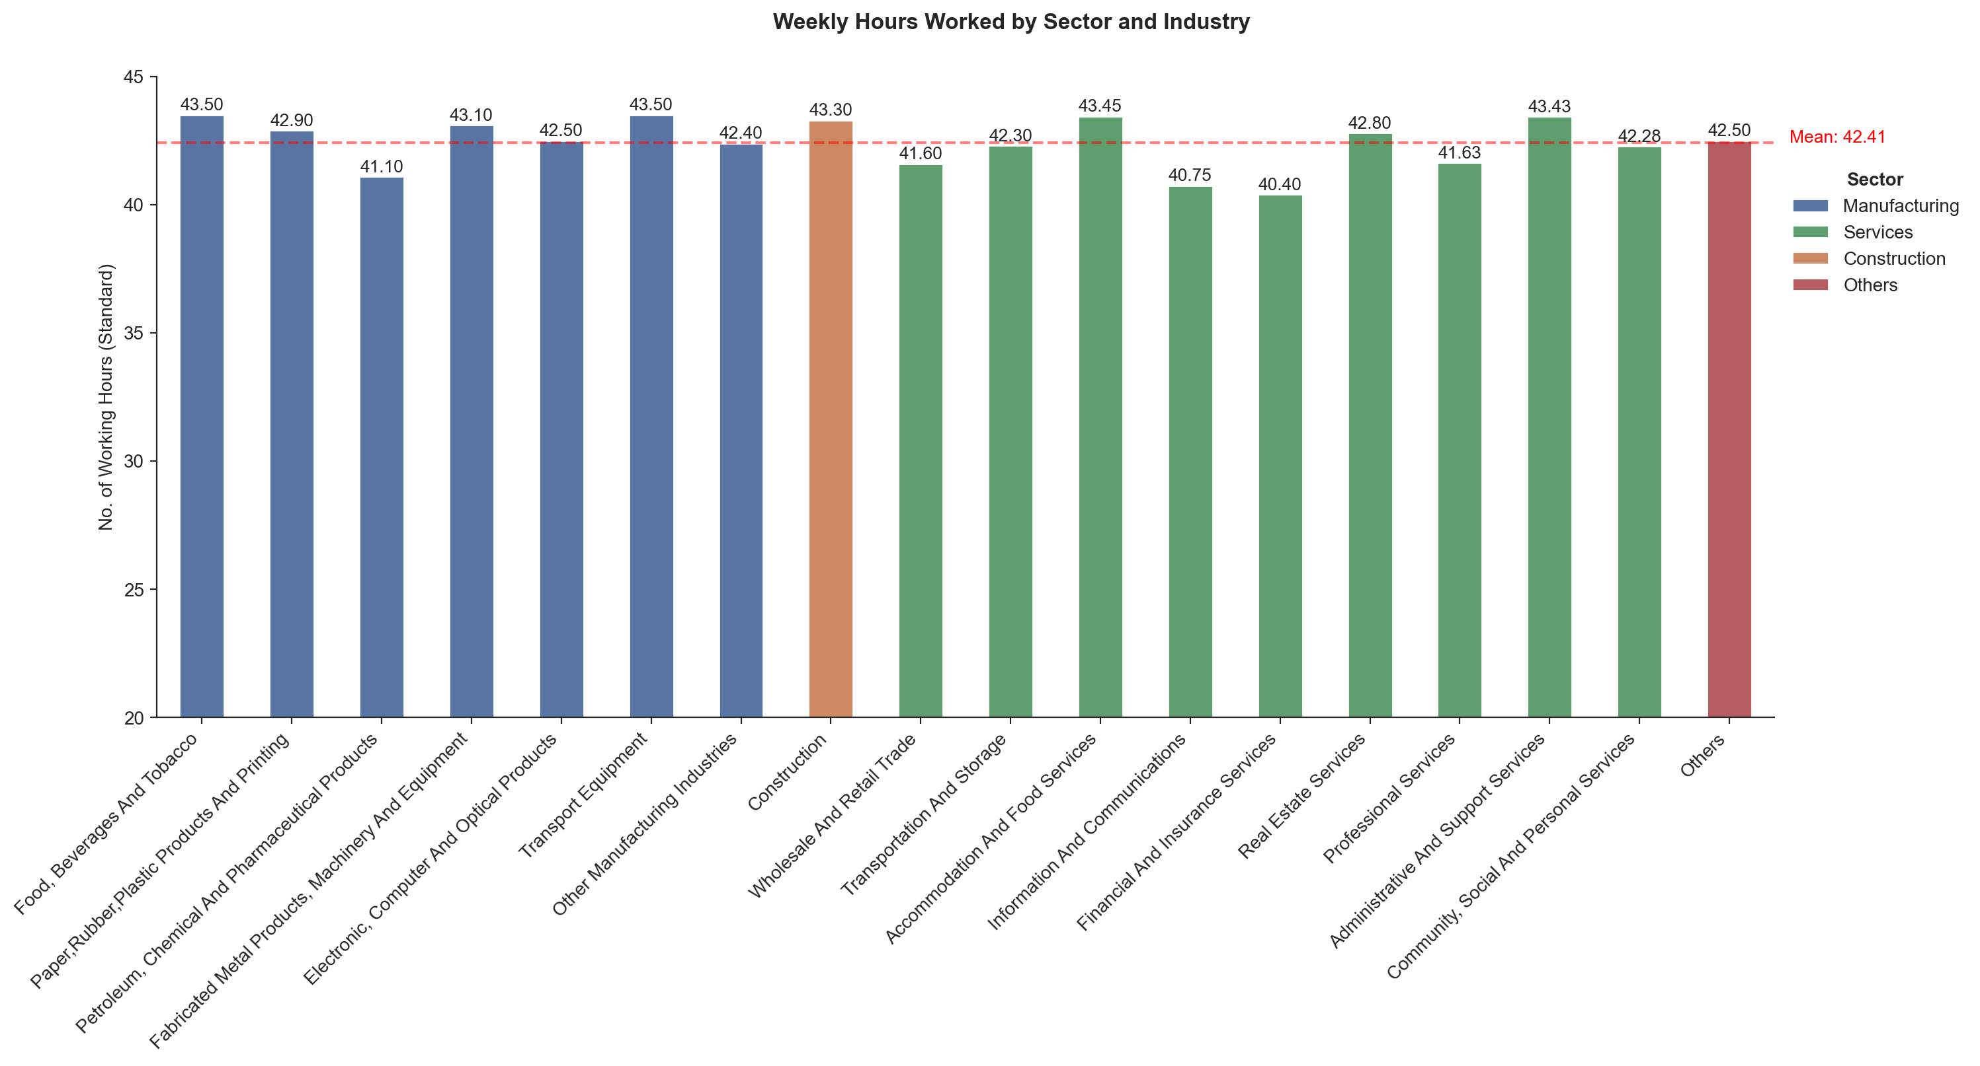
FINDINGS (WORK-LIFE BALANCE)
Analysis
Comparison of weekly working hours across industries and sectors to work-life balance
Insights
Fairly consistent working hours across industries, Services sector has the lowest mean working hours (42.1 hours)
E.g., IT, Financial & Insurance Services industries work 2 hours less than average
Transport Equipment, Construction, and Administrative & Support Services industries work 1 hour more than average

Slide 26
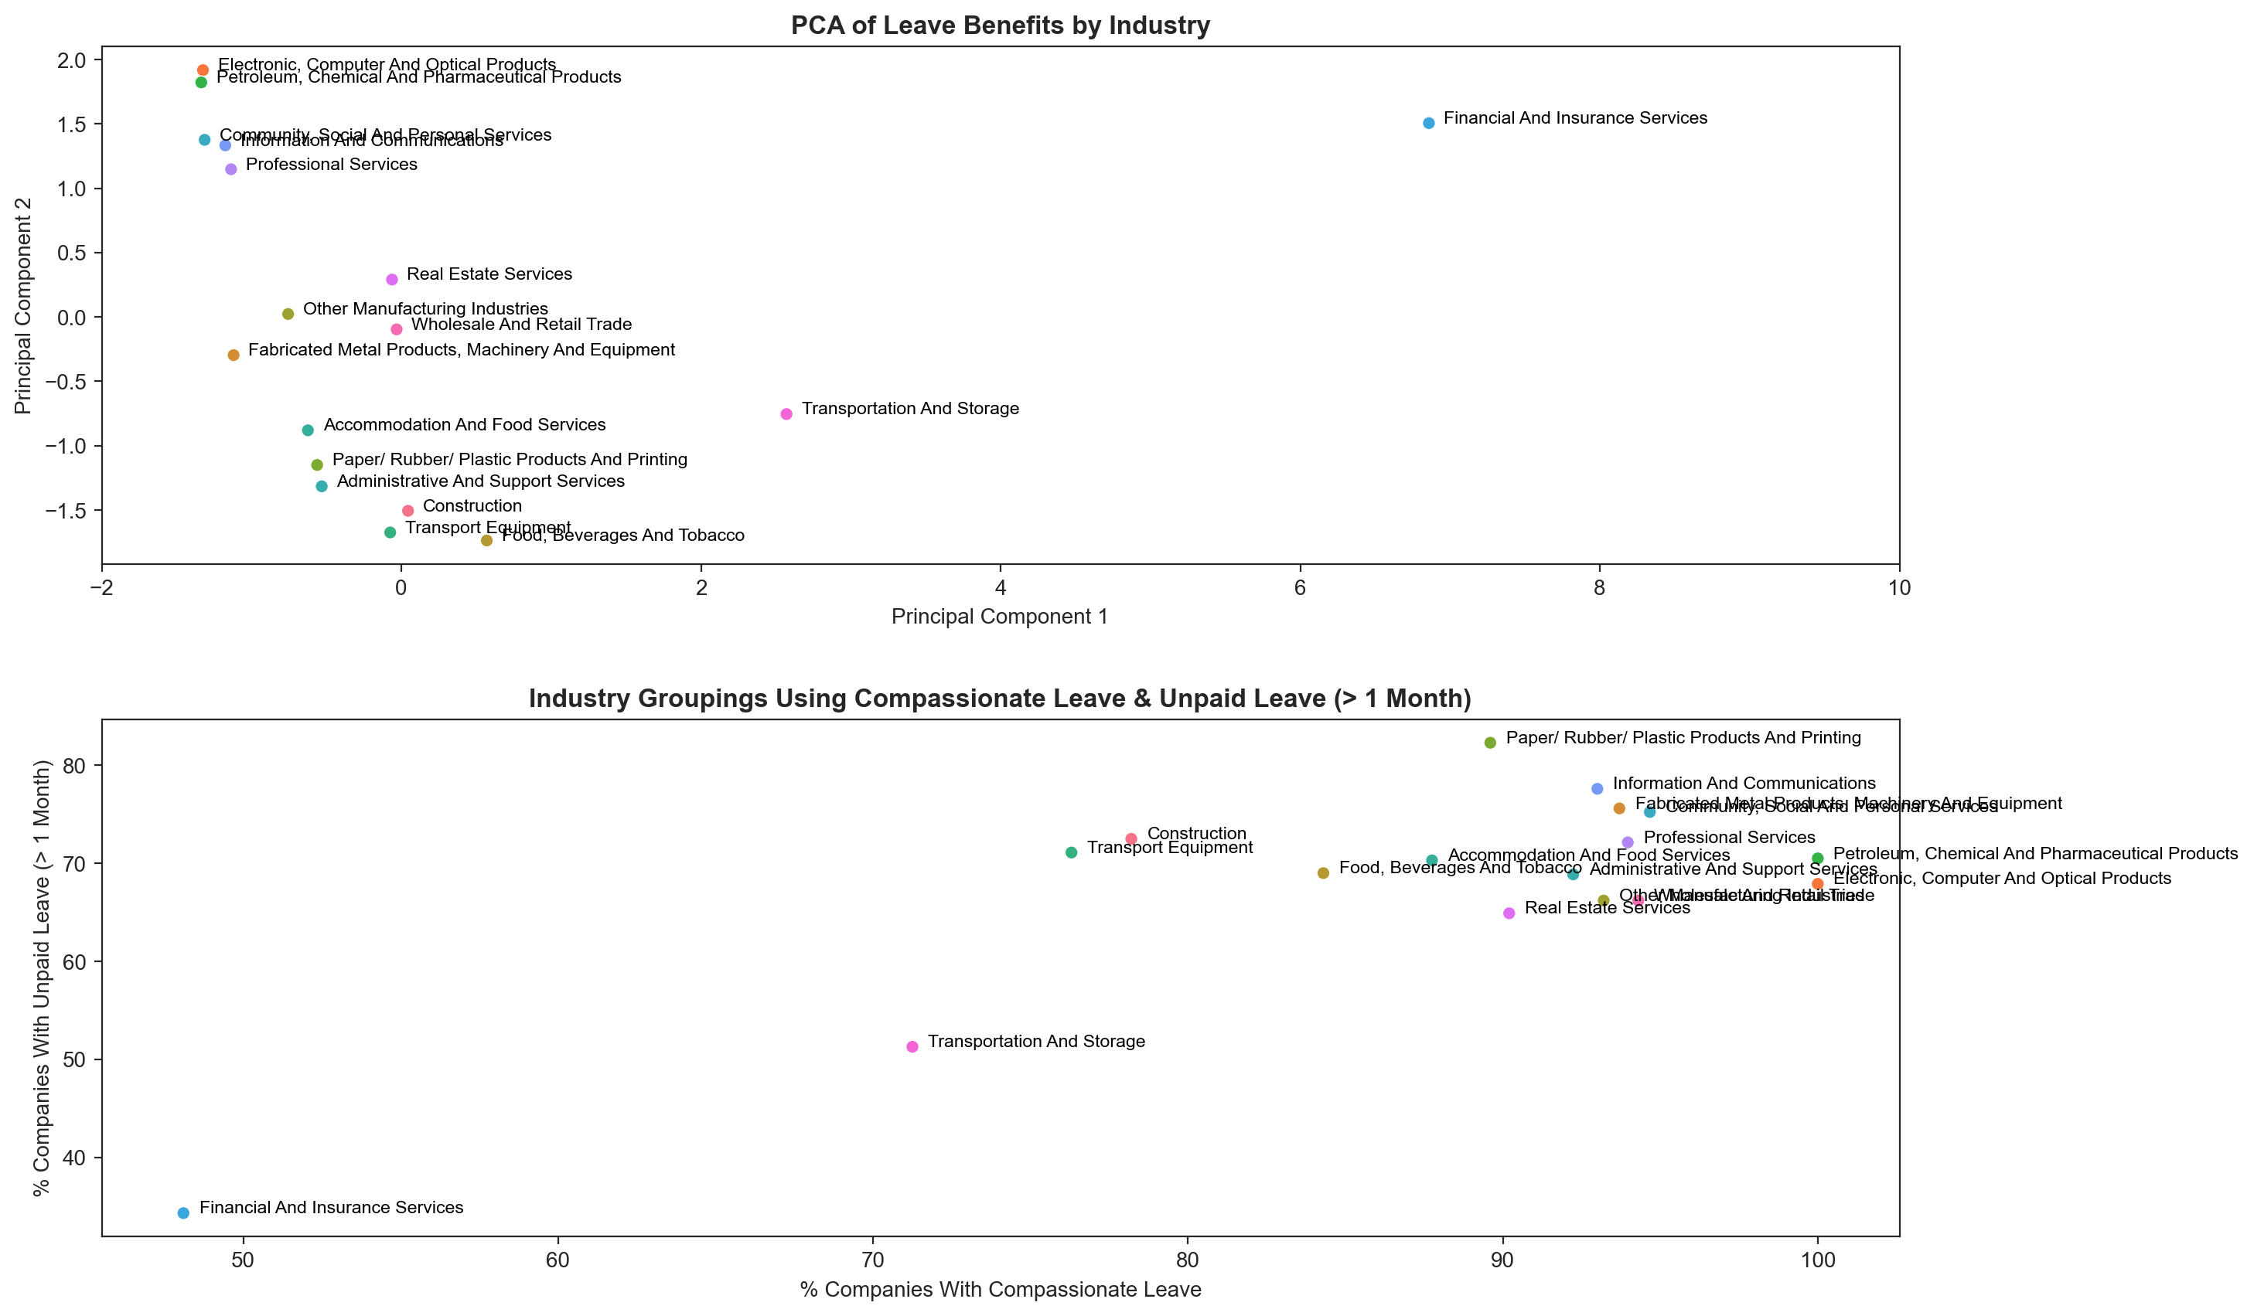
FINDINGS (LEAVE PACKAGE)
Analysis
PCA simplifies information on different leave types across industries into two principal components (PCs) for easy comparison of relative industry groupings by leave package
Insights
Compassionate and unpaid leave biggest differentiators, can be used as a start-point to examine differences in leave packages
E.g., Financial & Insurance Services industry low compassionate and unpaid leave but also highest annual leave compared to mean
Job-seekers can use this approach to compare leave package across industries based on groups

Slide 27
FINDINGS (FLEXIBLE WORKING ARRANGEMENTS)
Analysis
Comparison of FWAs across industries to determine industries with greatest flexibility
Insights
Most companies in Singapore offer WFH
Compressed work week not yet the norm, with full-time home-working and job-sharing being rare across all industries
Part-time work prevalent in Services sector
Staggered hours and tele-work (remote working) considerably higher in tertiary industries such as IT, Financial and Insurance Services, Electronic & Computer Products

Slide 28
KEY TAKEAWAYS
1
2
3
Singapore is doing well compared to other countries
Job-seekers must balance job security and satisfaction expectations
IT sector (us) probably not doing very well, benefits are good though
Despite concerns and fears, data shows Singapore’s job market outperforms other countries (things could be worse)
In a tight job market, job-seekers should prioritise job security and be ready to seize opportunities when conditions improve
2nd highest retrenchment levels in 2023, little resignations and thin recruitment opportunities ☹

Slide 29

CONCLUSION
What Now?
Despite economic challenges, Singapore’s job market demonstrates resilience and performs well compared to other countries. While the pursuit of job benefits is important, job-seekers need to carefully and strategically balance with job security in both the short and long-term.
While the labour market within Singapore may be tight now, the potential for growth opportunities exists. Staying adaptable and prepared will be crucial for capitalising on future opportunities when markets recover and rebound.

Slide 30
THANK YOU

